Slide 1

Department of Computer Applications
ITA3099 – Capstone Project Review -3
HELLO!
FRAME WORK FOR THE SMART HOME AUTOMATION IN INTEGRATION
WITH CLOUD
Presented By :
MAHESH KUMAR M(22BCA0238) HARI PRASATH M(22BCA0241)
VIT University | 2025

Slide 2
OVERVIEW
Abstract
Objectives
UML Diagrams
Alternatives
Introduction
System Components
Project Scope
System Architecture
Summary
1

Slide 3
ABSTRACT
The advent of the Internet of Things (IoT) has revolutionized the concept of
smart homes. This smart home automation system integrated with cloud computing. The system utilizes a network of actuators to monitor and control various home appliances, lighting, and security systems. Smart home automation enhances convenience, energy efficiency, and security. However, existing
systems often rely on local storage and manual updates, leading to limited scalability,
data accessibility issues, and lack of centralized control. While these systems offer quick responses and cost-effectiveness, they are prone to hardware failures and interoperability challenges.
2

Slide 4
INTRODUCTION
The Internet of Things (IoT) has revolutionized the way we interact with our
living spaces, giving rise to smart home automation systems that enhance convenience,
security, and energy efficiency. Smart home automation integrates various IoT-enabled devices to create a cohesive, interconnected environment, enabling homeowners to control and monitor appliances, lighting, and other home features remotely.
This project focuses on developing a framework for smart home automation integrated with cloud technology. Cloud integration plays a pivotal role by offering scalable data storage, advanced analytics, and real-time processing capabilities
3

Slide 5
INTRODUCTION
By leveraging the cloud, smart home systems can provide enhanced functionality, including remote access, predictive automation, and seamless device synchronization.
The proposed framework addresses key challenges such as interoperability between devices, data security, and system scalability. It highlights the integration of IoT devices with a cloud-based infrastructure to achieve a robust and user-friendly solution.
4

Slide 6
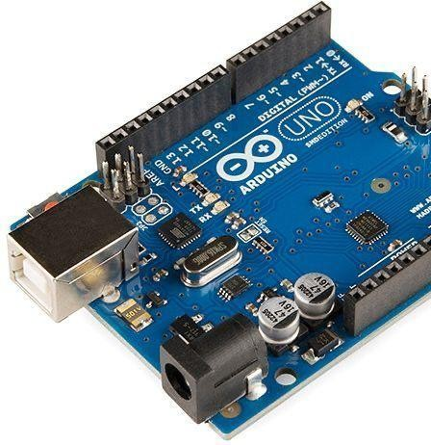
SYSTEM COMPONENTS
What is Arduino?
Open-source microcontroller for electronic projects.
Reads inputs (sensors, buttons) and controls outputs (LEDs, motors Programmable using Arduino IDE (C/C++).
Popular for prototyping among students and engineers.
How Arduino Works?
Powering the Board - Powered via USB, battery, or adapter. Connecting Components - Sensors, LEDs, motors connected to input/output pins.
Writing & Uploading Code - Code written in Arduino IDE and uploaded via USB.
Processing & Execution - Microcontroller processes instructions in real- time.
Controlling Outputs - Executes commands to control devices like lights and
).
5
motors.

Slide 7
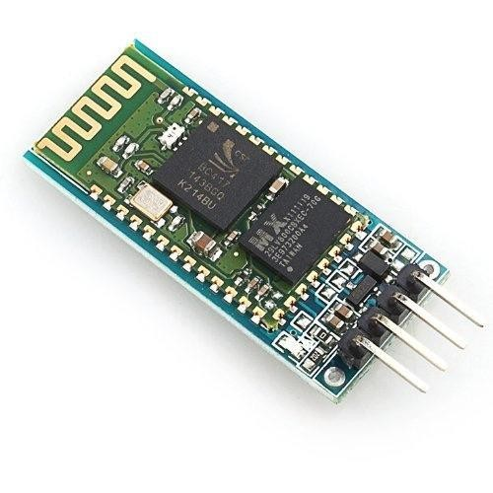
SYSTEM COMPONENTS
6
What is HC-05 Bluetooth Module?
Wireless Bluetooth module for communication between devices. Used in IoT, robotics, and wireless control applications.
Supports Master and Slave modes for two-way communication.
Works on Bluetooth 2.0 + EDR (Enhanced Data Rate) technology. How HC-05 Works?
Data Transmission - Sends and receives data wirelessly using UART communication.
Controlling Devices - Can control LEDs, motors, or appliances using a mobile app.

Slide 8
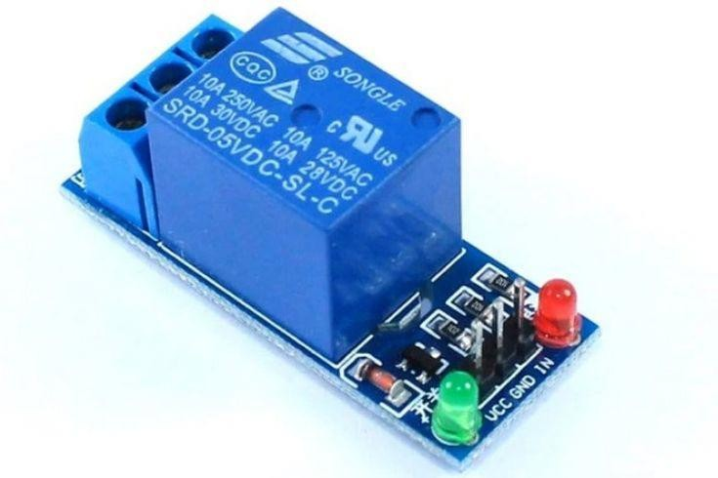
SYSTEM COMPONENTS
7
What is a Relay?
Electrical switch that opens or closes a circuit using an electromagnetic coil.
Allows low-power circuits (like Arduino) to control high-power devices (motors, lights, fans).
Used in home automation, industrial control, and automotive applications.
How a Relay Works?
Switching the Circuit - The relay connects or disconnects the high-power circuit.
Can work as Normally Open (NO) or Normally Closed (NC) based on design.
Controlling High-Power Devices - Used to control bulbs, fans, motors, heaters, and other appliances.

Slide 9
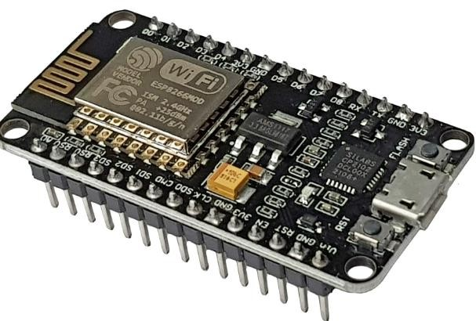
SYSTEM COMPONENTS
8
What is a Esp 8226?
The ESP8266 is a low-cost,Wi-Fi-enabled microcontroller widely used for IoT (Internet of Things) projects, home automation, and DIY electronics. It's popular due to its:Key Features1.Wi-Fi connectivity: Allows devices to connect to the internet and communicate with other devices.2. Microcontroller: Can run small programs and interact with sensors, actuators, and other components.
How does a Esp8226 work?
Key Components are Wi-Fi Module:The ESP8266 has a built-in Wi-Fi module that allows it to connect to Wi-Fi networks.

Slide 10
OBJECTIVES
9
The main objective of this project is to develop a scalable and user-friendly
framework for smart home automation by integrating IoT devices with cloud-based
infrastructure. It aims to ensure seamless communication and interoperability between
different devices, enhance data security and privacy, and improve system scalability
to handle a growing number of devices effectively.The project also focuses on
optimizing energy consumption to promote sustainability and creating an intuitive
interface for easy control and monitoring.

Slide 11
OBJECTIVES
10
Additionally, it seeks to leverage cloud
capabilities for advanced features such as real-time monitoring, remote access, and
predictive automation, providing a cost-effective and reliable solution to overcome
current challenges in smart home systems.

Slide 12


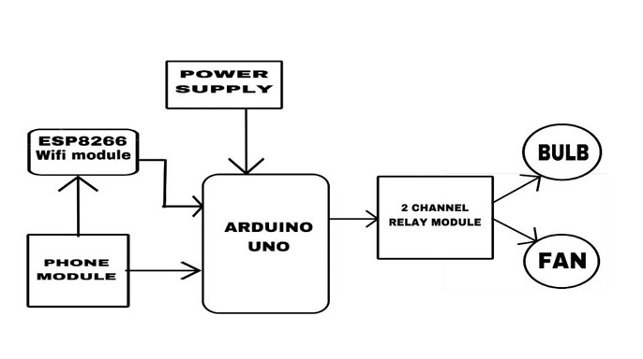
SYSTEM ARCHITECTURE

Slide 13
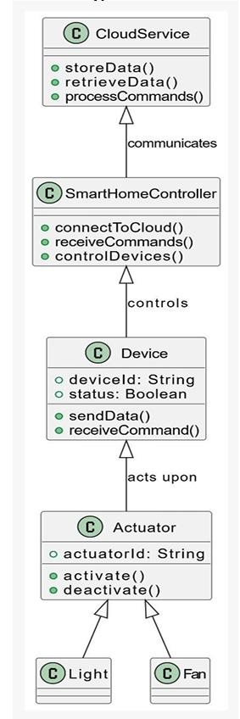
CLASS DIAGRAM

Slide 14


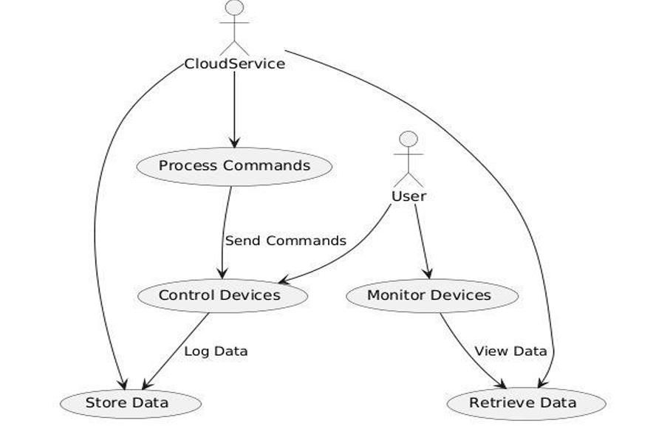
USE CASE DIAGRAM

Slide 15
ALTERNATIVES
2. Blynk Cloud can be replaced with MQTT protocol by a private cloud
1. For instance, substituting for Wi-Fi (ESP8266) is mobile network-
based control using a GSM Module (SIM800L).
server for enhanced security.
3. Also, Arduino Uno can be replaced with ESP32, which supports
onboard Wi-Fi and Bluetooth, reducing the use of external modules.
11

Slide 16
PROJECT SCOPE
This project focuses on developing a framework for smart home automation by
integrating IoT devices with cloud-based infrastructure. The framework is designed to
provide seamless communication and interoperability among diverse smart devices,
enabling users to control and monitor their homes efficiently. It addresses key
challenges such as data security, scalability, and energy efficiency while ensuring a
user-friendly experience.
12

Slide 17
SYSTEM SPECIFICATION
HARDWARE CONFIGURATION: SOFTWARE CONFIGURATION:
microcontroller: Arduino Uno (ATmega328P)
Basic Software
Wi-Fi Module: ESP8266 (for cloud-based remote control)
Bluetooth Module: HC-05 (for local control)
Relay Module: 2-Channel/4-Channel Relay (to turn appliances ON/OFF)
Power Supply: 9V – 12V Battery / 5V USB Adapter
Switches: Manual switches for direct appliance control
Jumper Wires: For connecting components
PCB or Breadboard: For assembling circuit
Light Bulb / LED Lamp: To test automation
Electric Fan: Controlled via relay for home automation
* Arduino IDE – For programming and uploading the program to Arduino
* C/C++ (Arduino Language) – For programming the microcontroller
* Blynk IoT App – For cloud-based remote monitoring and control
Basic Communication Libraries
* ESP8266WiFi Library – Supports Wi-Fi communication
* Blynk Library – For communication with Blynk Cloud
* SoftwareSerial Library – For Bluetooth-based communication
13

Slide 18
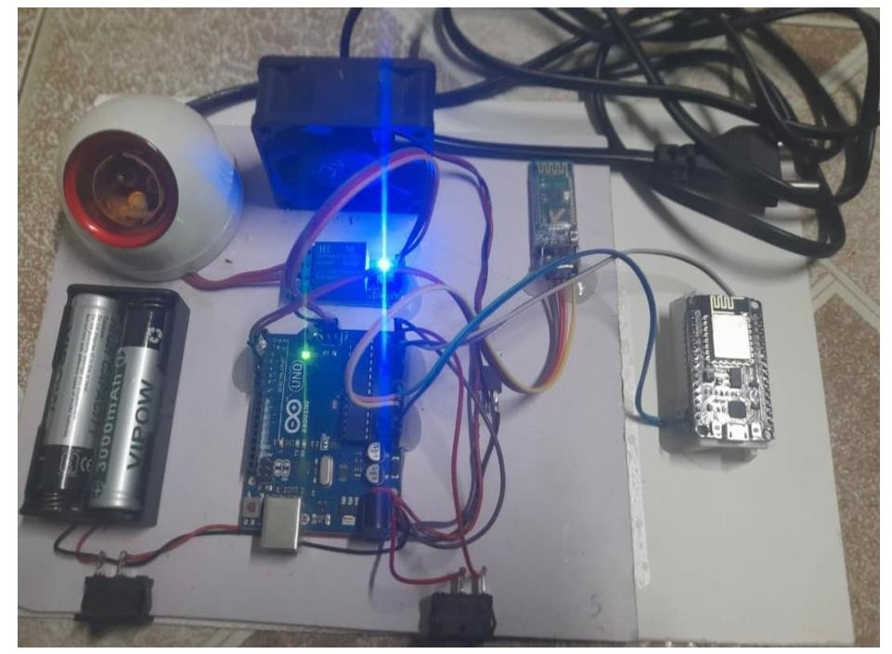

SYSTEM OUTPUT
14

Slide 19
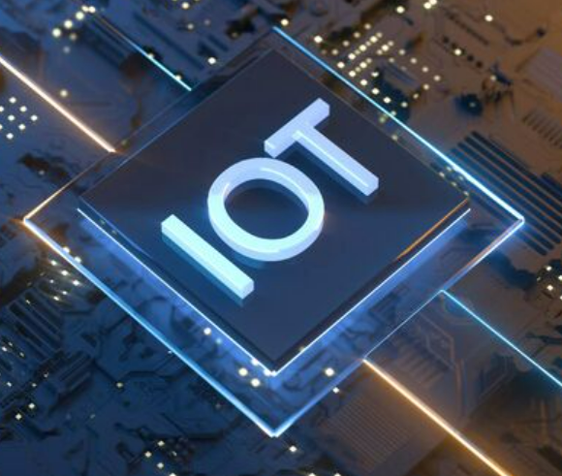
SUMMARY
This project report deals with the design and development of a Smart Home Automation System for remote and local control of home electric appliances using Wi-Fi (ESP8266), Bluetooth (HC-05), and the Blynk Cloud platform. The system offers more convenience to the user, security, and energy saving by controlling appliances such as lights and fans remotely using a mobile app and manual switches too. The initial objective of the project is to develop low-cost, flexible, and scalable automation hardware that will easily be installed in small office or home environments without radically changing buildings or spending large amounts of capital on equipment.
The system architecture provides a number of control options. Wi-Fi control is gained via the
usage of the ESP8266 Wi-Fi module that communicates with the Blynk Cloud, sending instructions to manage devices remotely using a smartphone application by an individual. Bluetooth local control is achieved via the usage of the HC-05 module to provide control locally in situations of no connection to the internet.
18

Slide 20

THANK YOU

